Slide 1

AI-Powered Resume Screening System: Intelligent NLP-Based Candidate Ranking
Submitted By: Mudassar Nazar & Amjid Wasim
Submitted To: Faisal Hafeez
内容由AI生成

Slide 2

CONTENTS
01
Project Overview
02
Key Features
PART
PART
03
How AI Works in This Project
04
How to Use
PART
PART
05
Project Structure
06
Example Usage
PART
PART
07
Bias Detection Feature
08
Technical Details
PART
PART
内容由AI生成

Slide 3

PART 01
Project Overview
内容由AI生成

Slide 4

System Introduction and Core Capabilities
Project Goal and Technology Stack
An AI-powered, professional-grade Resume Parser and Applicant Tracking System (ATS) built with a Next.js (TypeScript) frontend and FastAPI (Python) backend. The platform integrates spaCy NLP, PyMuPDF parsing to extract candidate profiles, evaluate match scores against job descriptions, and deliver actionable career insights.
Key AI Capabilities
The system features AI-powered skill extraction, multi-dimensional scoring, built-in bias detection, a modern responsive UI with theme toggle, and real-time candidate ranking. It ensures fair and efficient candidate evaluation through advanced algorithms.
内容由AI生成

Slide 5
PART 02
Key Features
内容由AI生成

Slide 6

Core Functionality
01
02
Resume Upload and Skill Matching
Comprehensive Scoring System
Supports multiple resume uploads in PDF and DOCX formats. It uses NLP techniques for intelligent skill extraction and semantic matching between resumes and job descriptions, ensuring accurate candidate profiling.
Implements a multi-component scoring system evaluating skills, experience, education, and keywords. This provides a holistic view of candidate suitability based on job requirements.
内容由AI生成

Slide 7
AI-Powered Features
Smart Recommendations and Role Suggestions
Generates AI-driven candidate suitability messages and automatically suggests job titles based on skill profiles. It also offers personalized improvement suggestions for low-scoring candidates.
Bias Detection and Fairness Analysis
Features advanced fairness analysis to identify potentially discriminatory ranking patterns, such as keyword bias, experience penalty, and education bias, promoting equitable hiring practices.
内容由AI生成

Slide 8
User Experience
Modern UI and Real-Time Results
Offers a clean, responsive interface with candidate cards, light/dark theme toggle, and instant analysis and ranking display. It provides detailed insights including score breakdowns and improvement suggestions.
内容由AI生成

Slide 9
PART 03
How AI Works in This Project
内容由AI生成

Slide 10
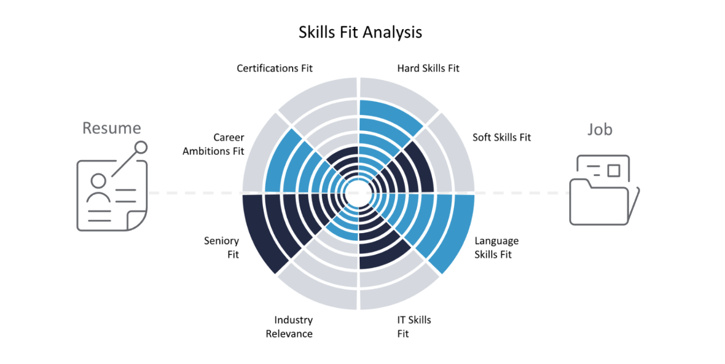
Skill Extraction and Matching
Uses exact matches, word boundary detection, and skill synonym recognition to handle variations like "Python programming" ↔ "Python developer". It performs case-insensitive matching with intelligent filtering for accuracy.
内容由AI生成

Slide 11
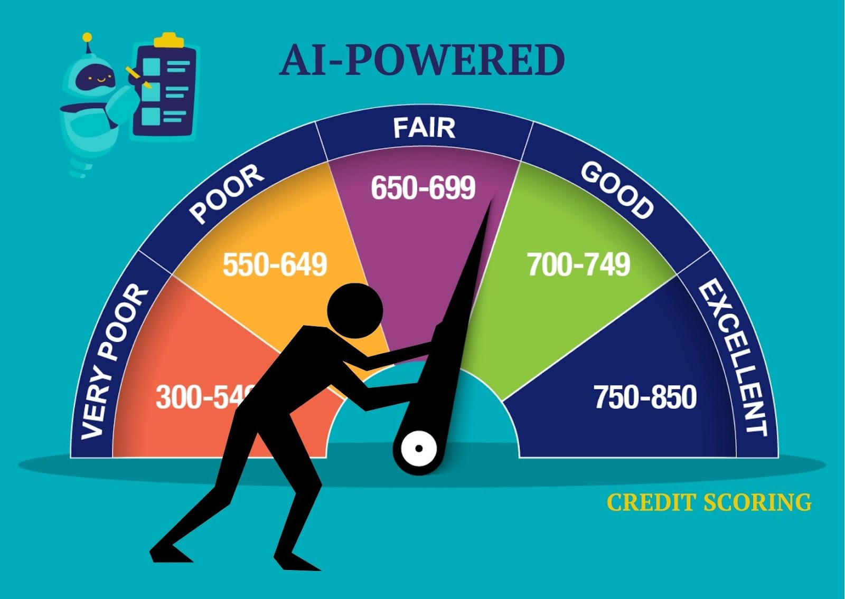
Intelligent Scoring Algorithm
Applies a custom weighted scoring formula: Skills Match (60%), Experience Evaluation (20%), Education Detection (10%), and Job Description Overlap (10%). This prioritizes skills as the primary factor in candidate ranking.
内容由AI生成

Slide 12
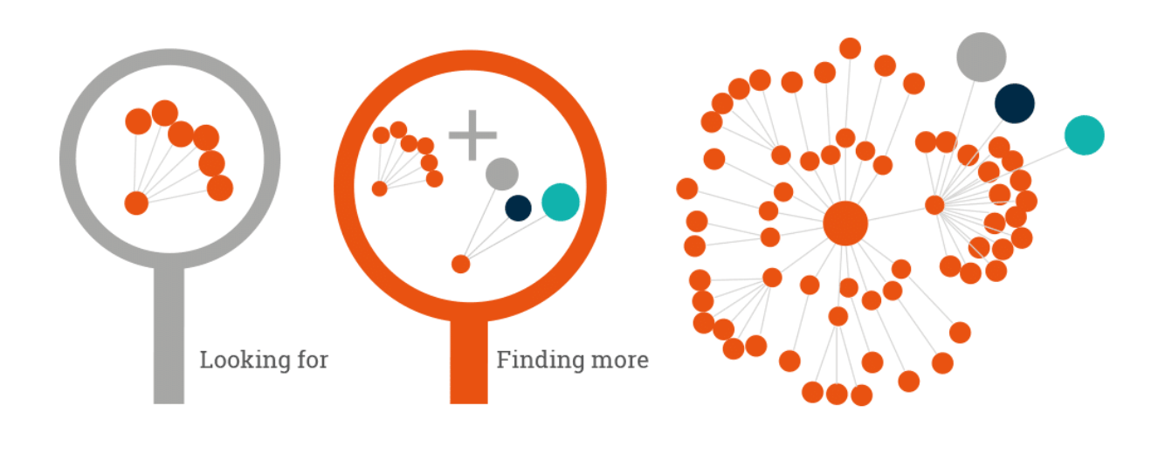
Semantic Similarity Analysis
Primary and Fallback Methods
Utilizes `sentence-transformers` for deep semantic understanding as the primary method, with TF-IDF vectorization as a fallback for keyword-based similarity. It compares meaning between job descriptions and resume content.
内容由AI生成

Slide 13

Bias Detection and Fairness Analysis
Anomaly Detection for Unfair Patterns
Identifies keyword bias, experience penalty, education bias, and keyword stuffing through statistical analysis, outlier detection, and pattern recognition to ensure fair ranking.
内容由AI生成

Slide 14


AI Recommendations
Contextual Messaging and Suggestions
Generates contextual candidate suitability messages, suggests appropriate job roles based on skill combinations, and provides actionable resume improvement suggestions for better outcomes.
内容由AI生成

Slide 15
PART 04
How to Use
内容由AI生成

Slide 16

Basic Workflow
Step-by-Step Process
Enter the complete job description in the first text area, list required skills separated by commas, upload multiple PDF or DOCX resume files, set the approval threshold (default: 70%), and click "Analyze & Rank Candidates" to process.
内容由AI生成

Slide 17

Understanding Results
Candidate Card Details
Each candidate card displays match score, status (Approved/Needs Improvement), skill analysis, score breakdown, AI recommendation, role suggestions, bias alerts, and improvement tips for comprehensive evaluation.
内容由AI生成

Slide 18
PART 06
Example Usage
内容由AI生成

Slide 19
Sample Scenario
01
02
Job Description and Input
Expected Output
Input a sample job description for a Python Developer with web development, data analysis, and machine learning experience. Specify required skills and upload sample resumes for testing.
The system outputs candidate ranking with scores, skill match analysis, AI recommendations, role suggestions, bias detection alerts, and resume improvement suggestions for actionable insights.
内容由AI生成

Slide 20
PART 07
Bias Detection Feature
内容由AI生成

Slide 21

Detected Bias Types
Fairness Analysis Categories
The system detects keyword bias, experience penalty, education bias, and keyword stuffing to identify potential discriminatory patterns in ranking.
内容由AI生成

Slide 22
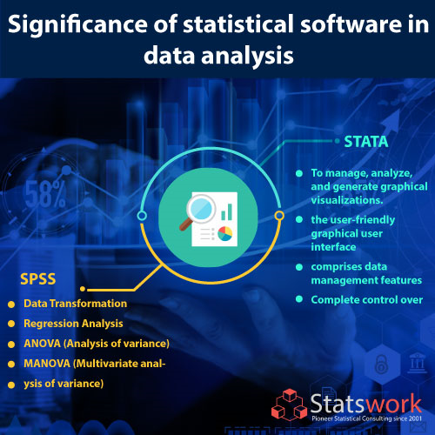
How It Works
Statistical Analysis Process
Uses statistical analysis of score distributions, outlier detection with standard deviation, cross-validation between scoring components, and pattern recognition for unfair indicators.
内容由AI生成

Slide 23
PART 08
Technical Details
内容由AI生成

Slide 24

Scoring Algorithm
Formula Implementation
The total score is calculated as (Skills × 0.6) + (Experience × 0.2) + (Education × 0.1) + (Keywords × 0.1), prioritizing skills as the main factor.
内容由AI生成

Slide 25
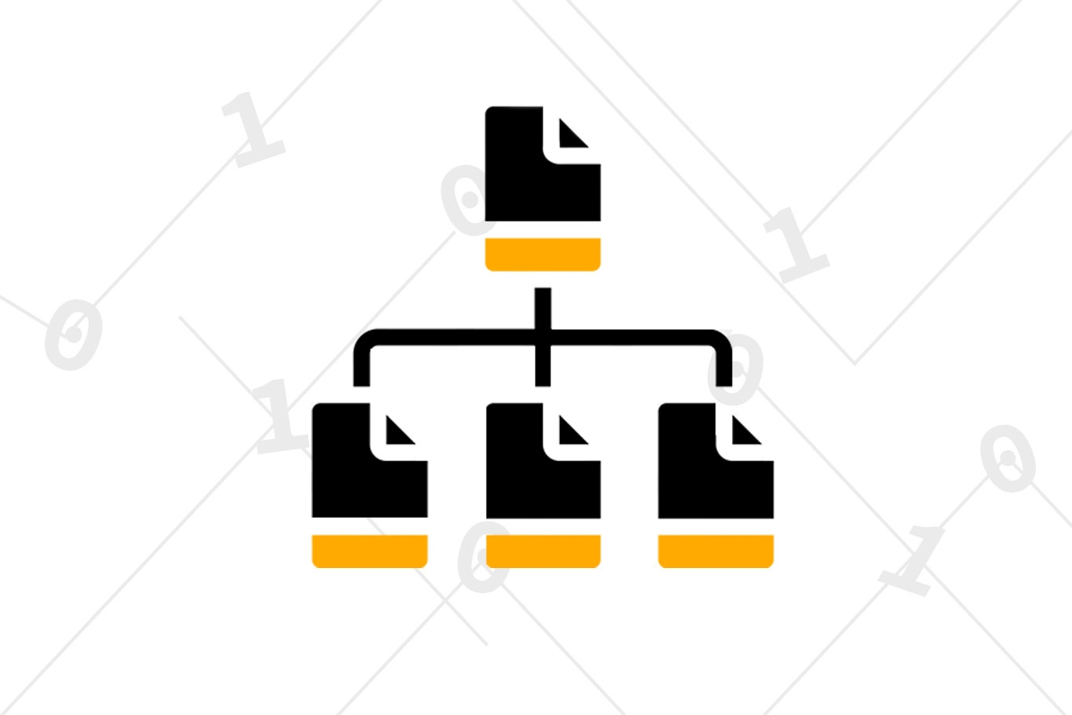
File Processing
Format Handling and Cleaning
Processes PDF with `pdfplumber` and DOCX with `python-docx`. It removes formatting artifacts and normalizes content for accurate text extraction.
内容由AI生成

Slide 26

Performance Tips
Optimization Recommendations
Use semantic search for better results by installing `sentence-transformers`, process fewer resumes at once for faster analysis, and ensure resumes are in clear, readable formats.
内容由AI生成

Slide 27
PART 09
Future Enhancements
内容由AI生成

Slide 28

Planned Features
Development Roadmap
Support for additional file formats, advanced NLP models, resume parsing for structured data, ATS integration, batch processing, custom scoring weights, and export to CSV/PDF formats are planned.
内容由AI生成

Slide 29
Thank you for watching.
内容由AI生成

